Slide 1

Library Management System

Slide 2
About me (Both Team Leader and Team Member)
Team Leader is Snigdha.
Background B-tech & MBA.
I choose Data Analytics to upgrade my technical skills in practical way which will show more opportunities in future.
Team Member: - Abhijit Palai
Background: MCA
I want to build a strong foundation in Data Science so I can design and work on Machine Learning models — moving from labeling and preparing data to actually building the models that learn from it.
LinkedIn: linkedin.com/in/abhijitpalai
GitHub: github.com/Abhijit-palai

Slide 3
Contents
Objective of the Project
Key analysis of questions (use cases)
Conclusion (Key finding overall)
Q&A Slide
Our Experience/Challenges

Slide 4
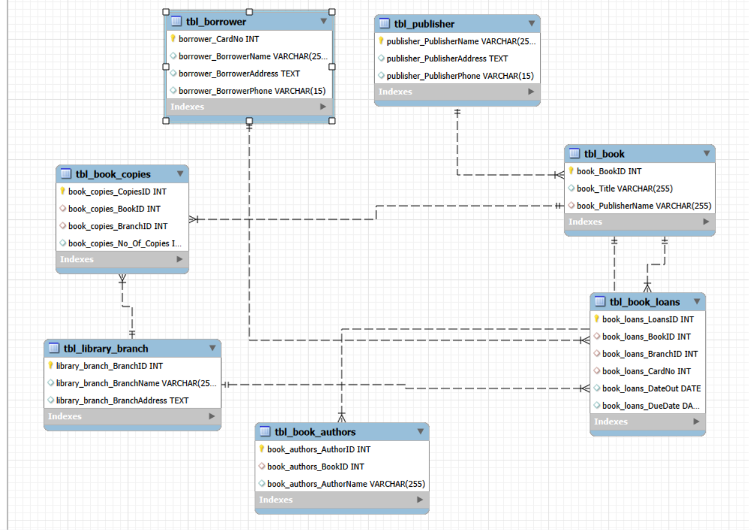
E-R Diagram

Slide 5
Objective of the Project
To analyze the Library Database and retrieve the required information by using SQL queries.

Slide 6
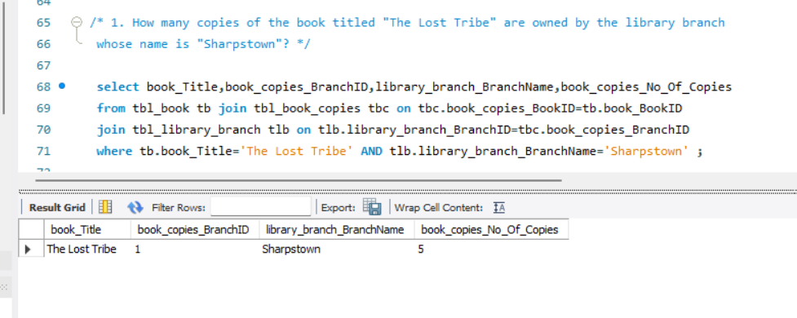
Key analysis of questions (use cases)
How many copies of the book titled "The Lost Tribe" are owned by the library branch whose name is "Sharpstown"?
By using multiple joins on tbl_books , tbl_book_copies and tbl_library_branch tables and where condition on book_Title and library_branch_branchname attributes ,No_of_copies of the book titled "The Lost Tribe" which was owned by the library_branch_name is "Sharpstown“ is retrieved.

Slide 7
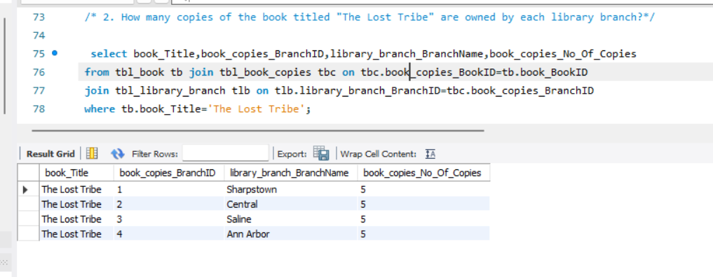
How many copies of the book titled "The Lost Tribe" are owned by each library branch?
By using multiple joins on tbl_books , tbl_book_copies and tbl_library_branch tables and where condition on book_Title attribute, No_of_copies of the book titled "The Lost Tribe" are owned by each library branch is retrieved.

Slide 8
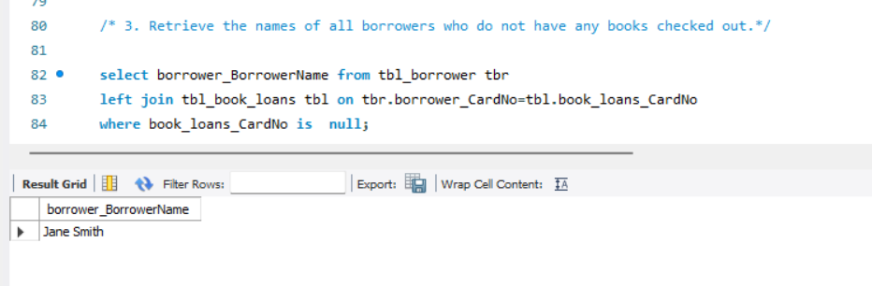
Retrieve the names of all borrowers who do not have any books checked out.
By using left join on tbl_Borrower and tbl_book_loans tables and where & is null condition on book_loans_cardNo attribute to retrieve the names of all borrowers who did not have any books checked out.

Slide 9
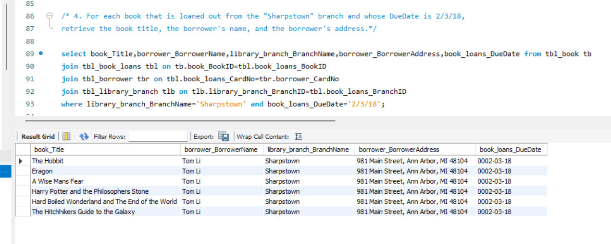
For each book that is loaned out from the "Sharpstown" branch and whose DueDate is 2/3/18, retrieve the book title, the borrower's name, and the borrower's address.
By using multiple joins on tbl_book , tbl_book_loans, tbl_borrower, tbl_library_branch tables and where condition on library_branch_BranchName & book_loans_DueDate attributes to retrieve book title, the borrower's name and the borrower's address for each book that is loaned out from the "Sharpstown" branch and whose DueDate is 2/3/18.

Slide 10
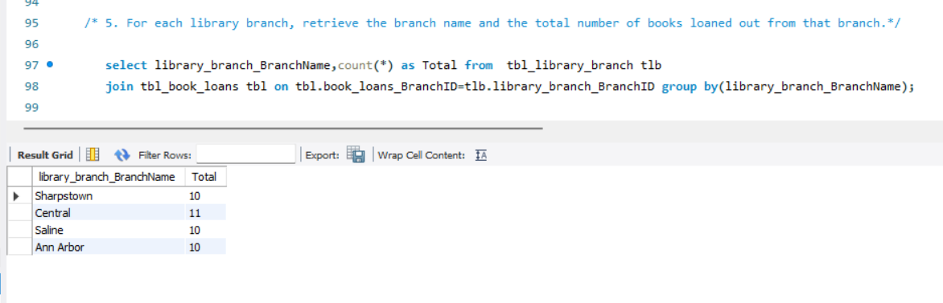
For each library branch, retrieve the branch name and the total number of books loaned out from that branch.
By using join i.e. inner join on tbl_library_branch, tbl_book_loans tables and group by on library_branch_BranchName attribute to retrieve the total number of books loaned out from that branch for each library branch by count aggregate function and branch name.

Slide 11
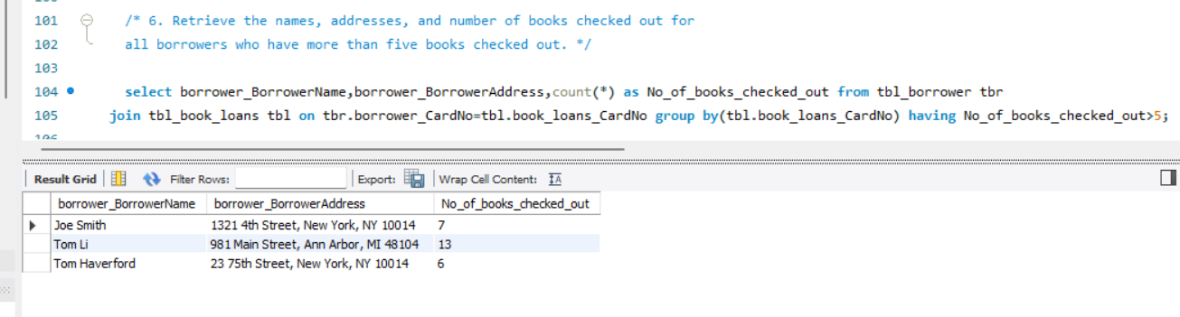
Retrieve the names, addresses, and number of books checked out for all borrowers who have more than five books checked out.
By using join i.e. inner join on tbl_borrower, tbl_book_loans tables and group by on books_loans_CardNo attribute, having condition on No_of_books_checked_out attribute to retrieve the number of books checked out for all borrowers who have more than five books checked out by count aggregate function and borrower_BorrowerName, borrower_BorrowerAddress.

Slide 12
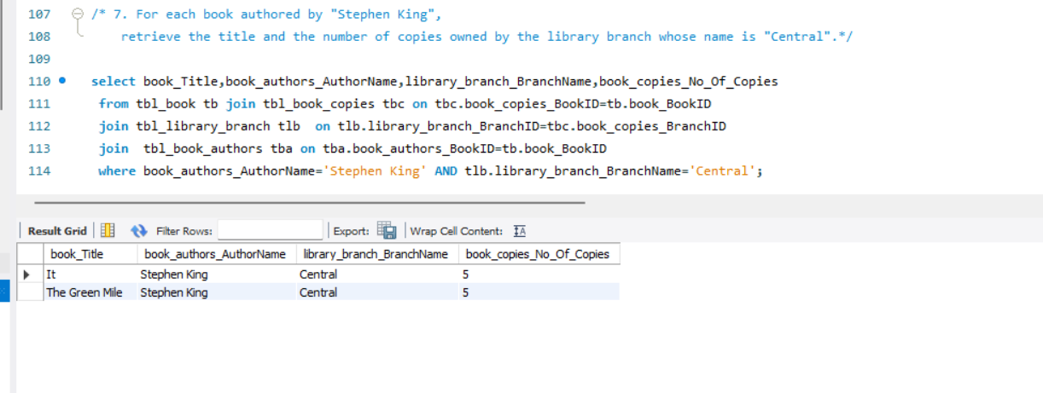
For each book authored by "Stephen King", retrieve the title and the number of copies owned by the library branch whose name is "Central".
By using multiple joins i.e. inner join on tbl_book_copies, tbl_book, tbl_library_branch, tbl_book_authors tables and where condition on book_authors_AuthorName & library_branch_BranchName attributes to retrieve the title and the number of copies owned by the library branch whose name is "Central“ and each book authored by "Stephen King".

Slide 13
Conclusion (Key finding overall)
No_of_copies of the book titled "The Lost Tribe" are owned by the library branch whose name is "Sharpstown“ is retrieved as 5.
No_of_copies of the book titled "The Lost Tribe" are owned by each library branch retrieved as for Sharpstown branch as 5 copies, for Central branch as 5 copies, for Saline branch as 5 copies, for Ann Arbor branch as 5 copies.
Names of all borrowers who do not have any books checked out is retrieved as Jane smith.
For each book that is loaned out from the "Sharpstown" branch and whose DueDate is 2/3/18 retrieved as 6 books i.e. The Hobbit, Eragon, A Wise Mans Fear, Harry Potter and the Philosophers Stone, Hard Boiled Wonderland and The End of the World, The Hitchhikers Guide to the Galaxy, currently due on 2/3/18 from the Sharpstown branch, and all of them are borrowed by Tom Li, whose address is 981 Main Street, Ann Arbor, MI 48104.
The total number of books currently loaned out from each library branch by grouping the loan records based on the branch name are Central has the highest number of books loaned out (11), while Sharpstown, Saline, and Ann Arbor each have 10 books loaned out.
There are 3 borrowers who have more than 5 books checked out. Tom Li with 13 books, Joe Smith with 7 books and Tom Haverford with 6 books.
The Central library branch owns two books authored by Stephen King—It and The Green Mile. Each title has 5 copies.

Slide 14
Any Queries?

Slide 15
Our Experience/Challenges
we faced bit difficulty to find out books checked out attribute as terminology is different and direct attribute is not there in any of the tables of library Database.
Overall used all the learned concepts in SQL module on library Database and gained practical knowledge.

Slide 16

THANK YOU

